Slide 1
Parham Pishro
y
Churn prediction in digital game-based learning using data mining techniques: Logistic regression, decision tree, and random forest

Slide 2
y
Churn prediction in digital game-based learning using data mining techniques: Logistic regression, decision tree, and random forest
digital
game-based
learning

Slide 3

Educational
Technology

Slide 4
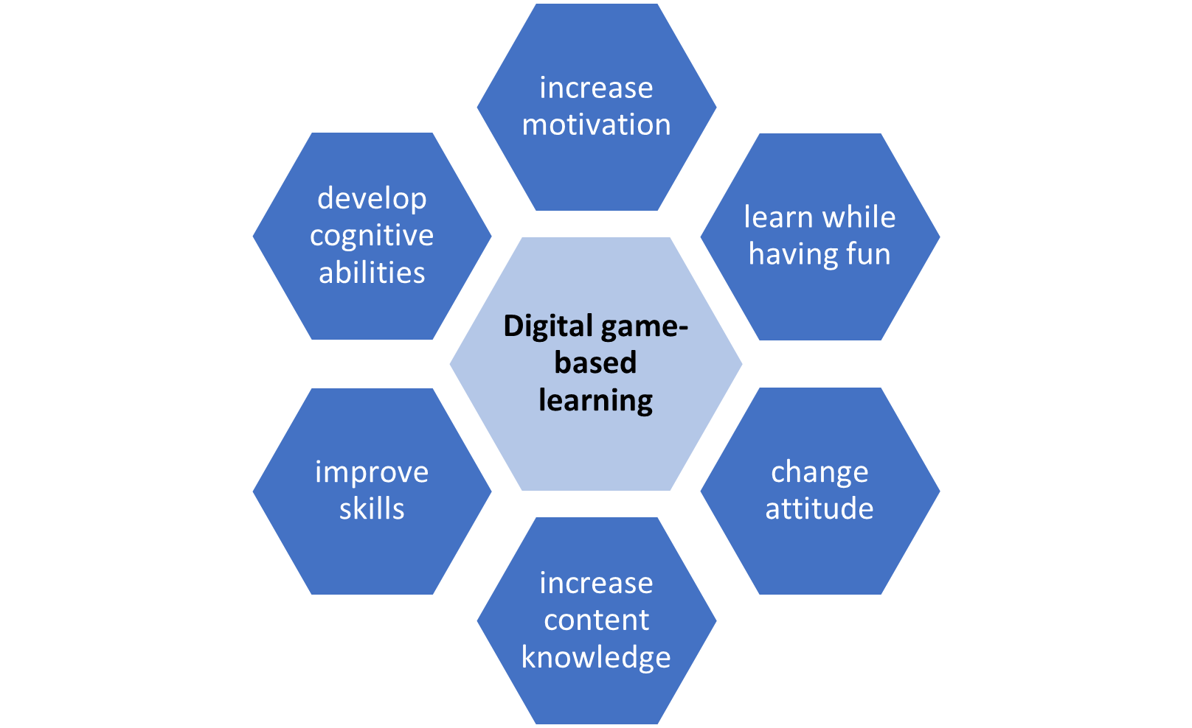
Marketing
Churn
Retention
Churn Prediction

Slide 5


Graduation Rate:
Virtual School) 50.1%
Overall) 84%
Median Churn Rate in
EdTech = 10.29%
EdTech

Slide 6
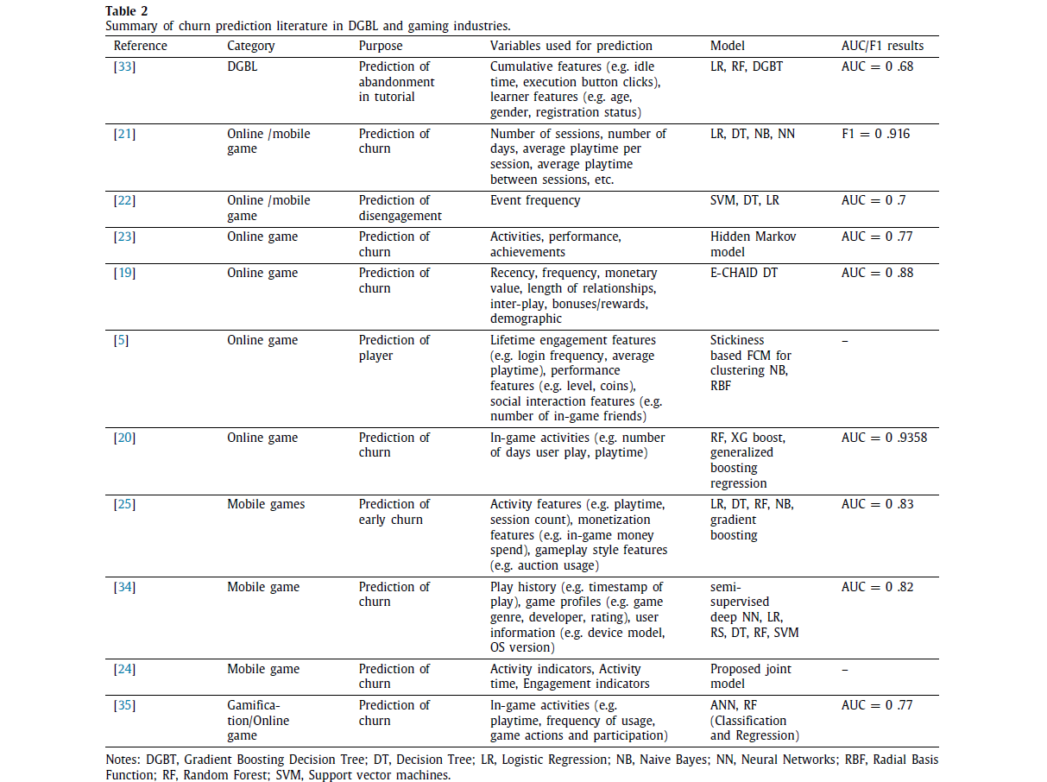
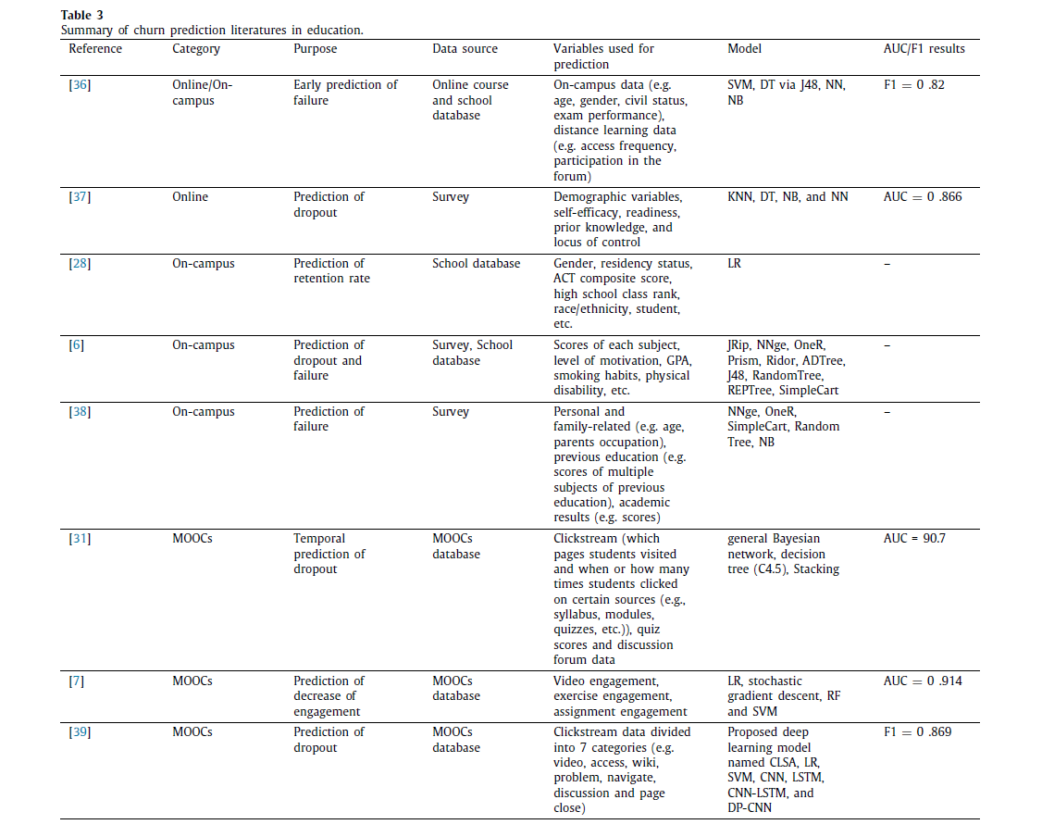
Related Works

Slide 7


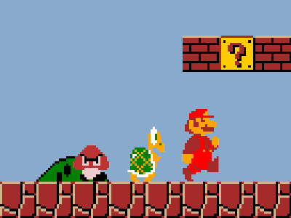
ole
lay
ame
R
P
G

Slide 8
C
O
N
T
E
N
T
S
Chapter 1 | Data Preparation
Chapter 2 | Churn Definition
Chapter 3 | Churn Determination
Chapter 4 | Retention Analysis
Chapter 5 | Hyperparameter Optimization
Chapter 6 | Churn Prediction and Evaluation
Chapter 7 | Discussion and Conclusion

Slide 9

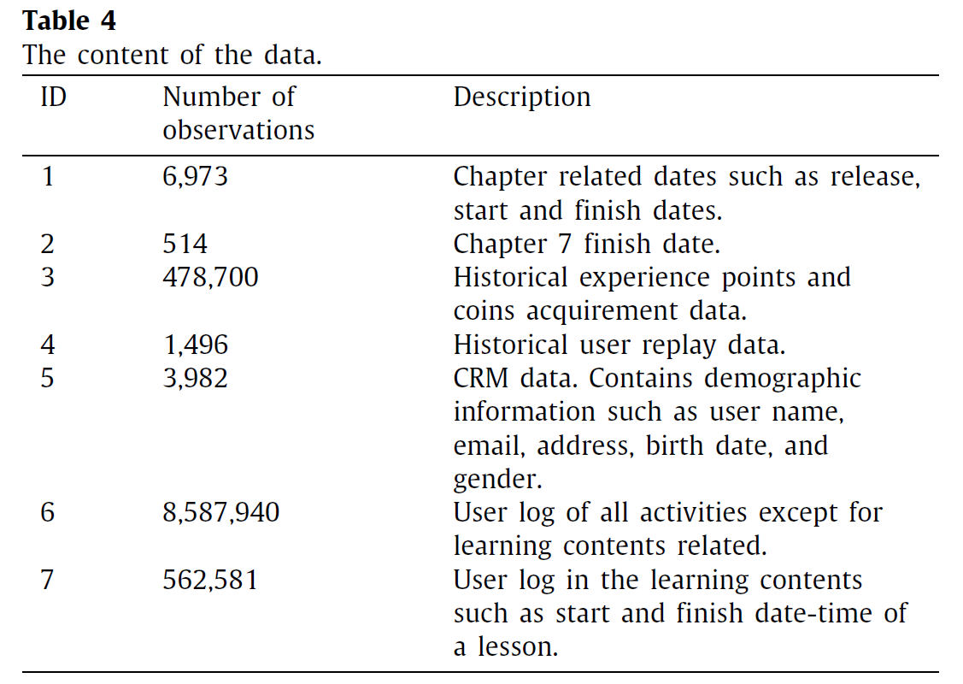
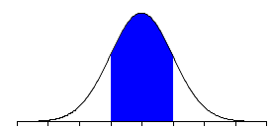


Data Collection
Data Preparation
Customer Relationship Management (CRM)
3557
Churn Definition
Two Types
of
Data
Churn Determination
Semi-Structured User Log Data
56% Female
44% Male
Retention Analysis
Hyperparameter
50%
Prediction
Evaluation
Discussion
17
33
Conclusion

Slide 10
Data Selection
Data Preparation
User id
Timestamp
Contents
Churn Definition
(from log data for computing the average or duration of logins, plays, and clicks number)
Churn Determination
Level
Number of coins
Retention Analysis
(called performance features)
Hyperparameter
Prediction
Gender
Date of birth
Resident area
Evaluation
(from CRM data)
Discussion
Conclusion

Slide 11
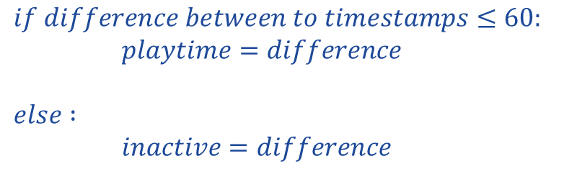
Data Aggregation, Transformation, and Integration
Data Preparation
User activity and lesson log integration
Experience points, coins, and replay data
CRM data transformation
Chapter progress data
Player data
Churn Definition
Churn Determination
Retention Analysis
Hyperparameter
$$if difference between to timestamps≤60:$$
$playtime=difference$
$$else :$$
$inactive=difference$
Prediction
Evaluation
Discussion
Conclusion

Slide 12
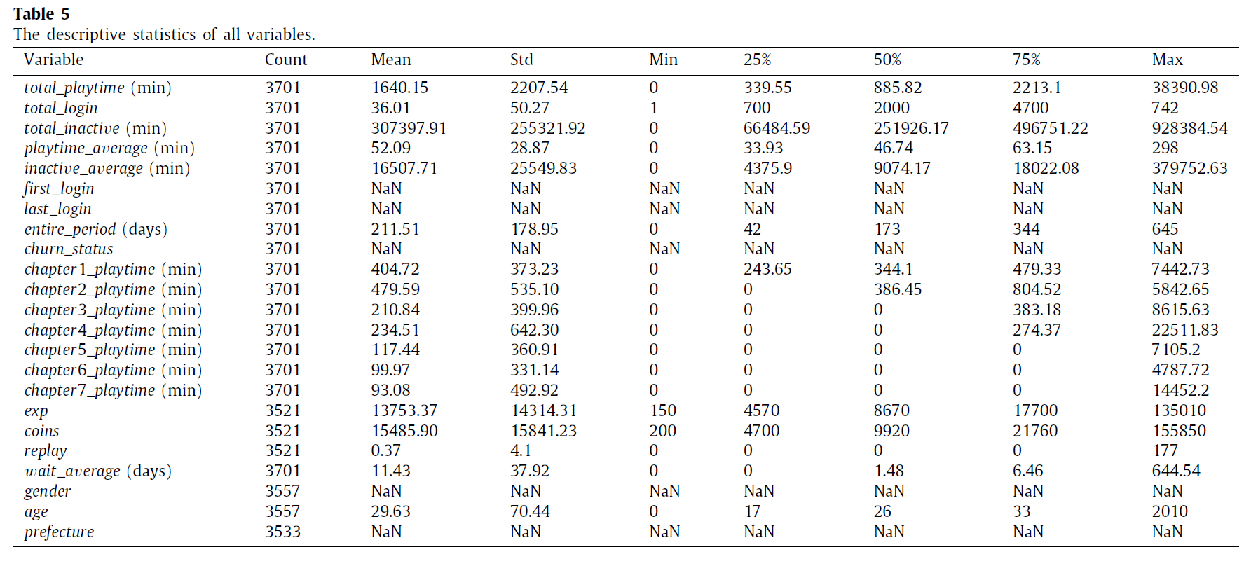
Exploratory Data Analysis (EDA)
Data Preparation
Churn Definition
Churn Determination
Retention Analysis
Hyperparameter
Prediction
Evaluation
Discussion
Conclusion

Slide 13
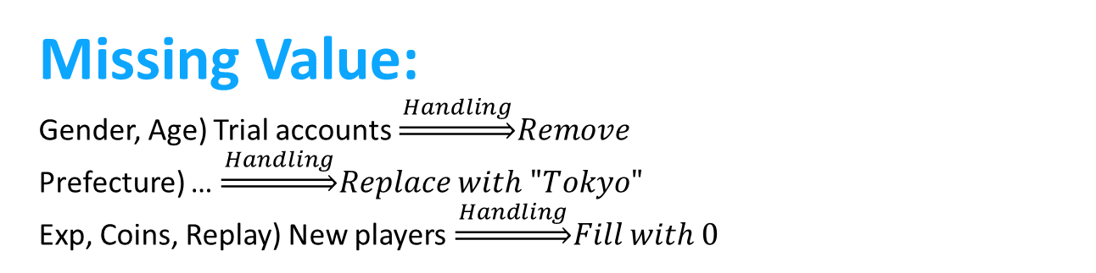

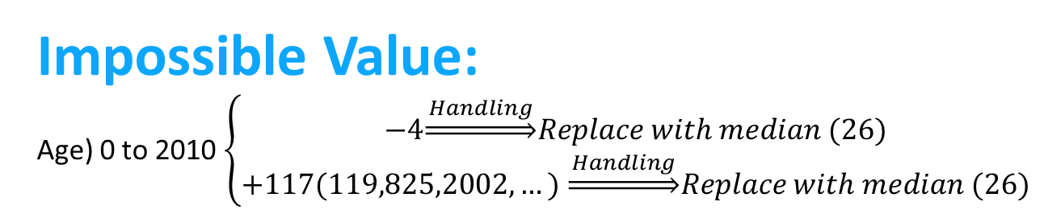
Data Cleaning
Data Preparation
Missing Value:
Gender, Age) Trial accounts $\underset{⇒}{ Handling }Remove$
Prefecture) … $\underset{⇒}{ Handling }Replace with "Tokyo"$
Exp, Coins, Replay) New players $\underset{⇒}{ Handling }Fill with 0$
Churn Definition
Churn Determination
Impossible Value:
Age) 0 to 2010 $\left\{\begin{aligned}−4\underset{⇒}{ Handling }Replace with median (26) \\ +117(119,825,2002,…) \underset{⇒}{ Handling }Replace with median (26)\end{aligned}\right.$
Retention Analysis
Hyperparameter
Outlier:
All of them) … $\underset{⇒}{ Handling }Standardization$
Prediction
Evaluation
Discussion
Conclusion

Slide 14
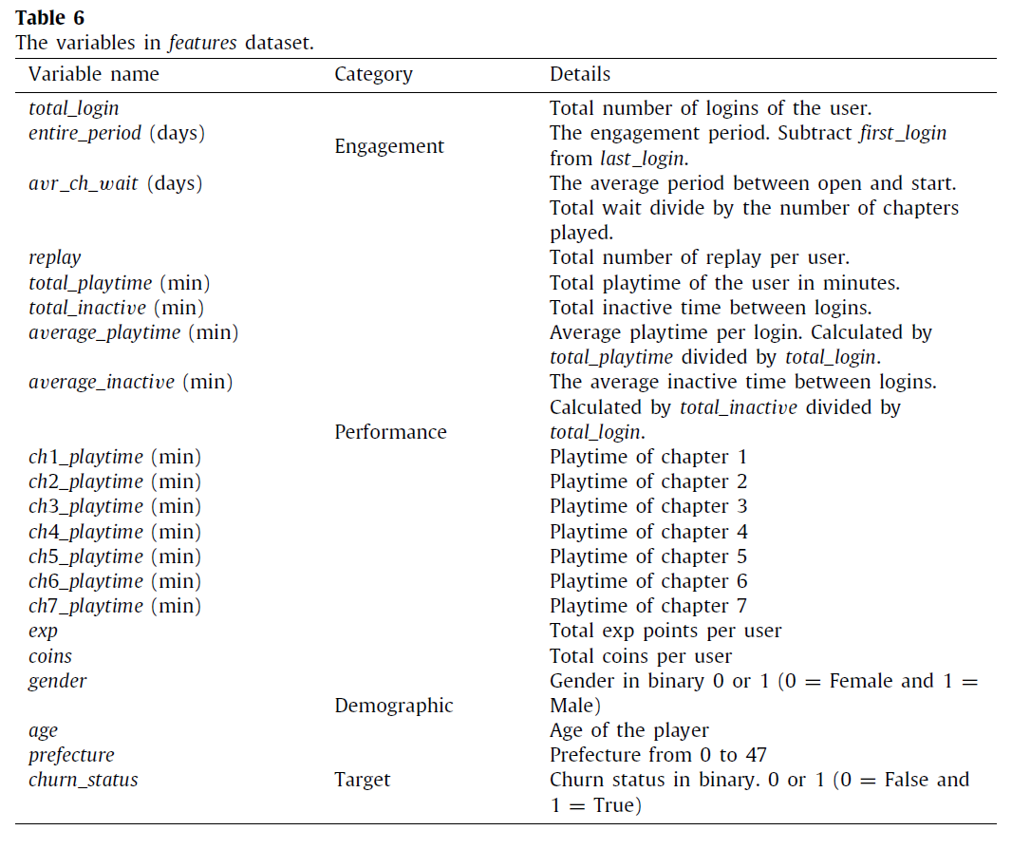
Features and Target
Data Preparation
Churn Definition
Churn Determination
Retention Analysis
Hyperparameter
Prediction
Evaluation
Discussion
Conclusion

Slide 15
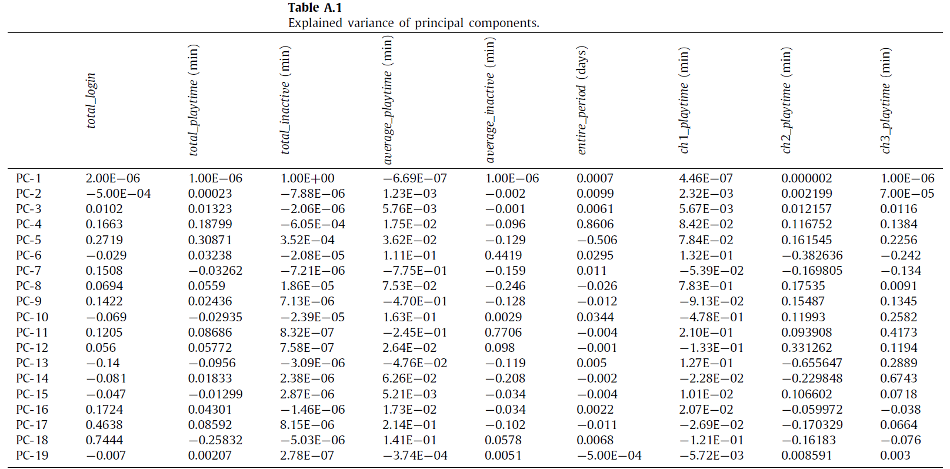
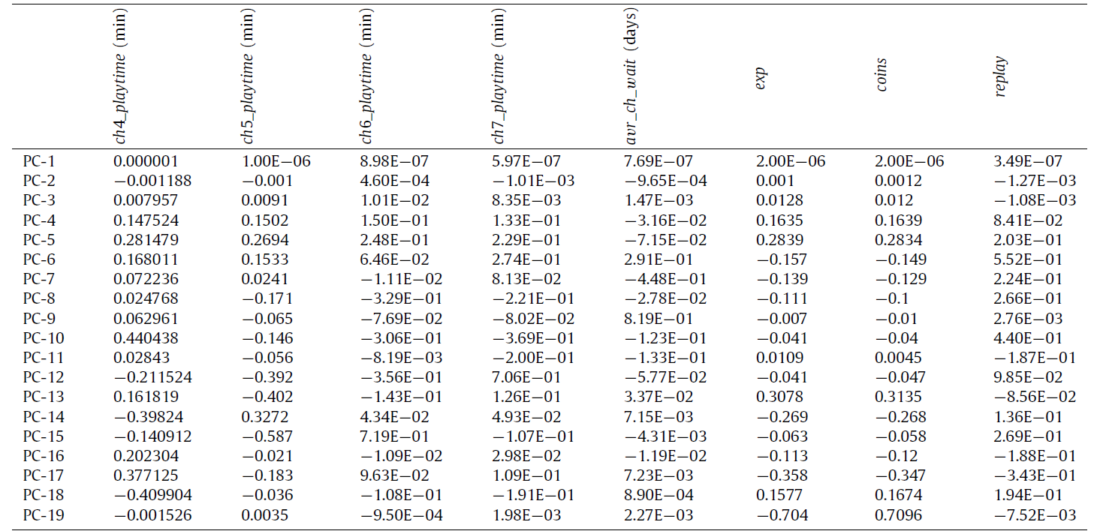
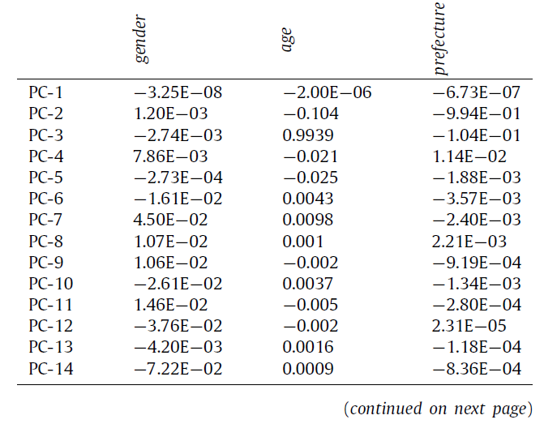
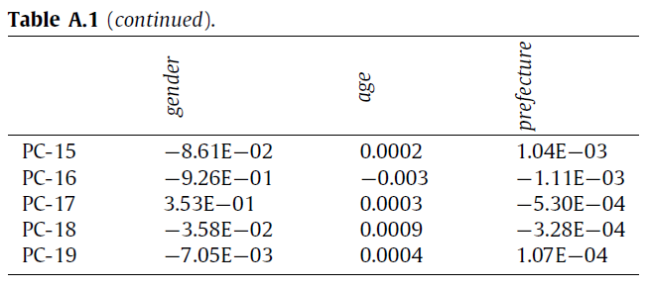
Feature Selection
Data Preparation
Churn Definition
Churn Determination
Retention Analysis
Hyperparameter
Prediction
Evaluation
Discussion
Conclusion

Slide 16


Definition of Churn (Education)
Data Preparation
Education Industry)
Churn Definition
work in the week
or
the end of the course
Churn Determination
Retention Analysis
Hyperparameter
Prediction
Evaluation
Discussion
Conclusion

Slide 17
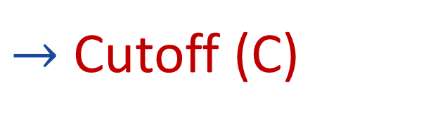
Definition of Churn (Game)
Data Preparation
Game Industry)
Churn Definition
Churn Determination
Retention Analysis
Inactivity Duration
$→$ Cutoff (C)
Hyperparameter
Prediction
Evaluation
Discussion
Conclusion

Slide 18
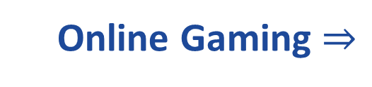
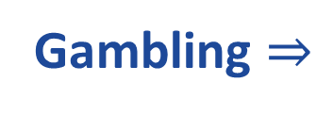
Definition of Churn (Gamble)
Data Preparation
Gamble Industry)
Churn Definition
Gambling $⇒$
Online Gaming $⇒$
Recency
Churn Determination
Retention Analysis
Hyperparameter
Prediction
Evaluation
Discussion
Conclusion

Slide 19
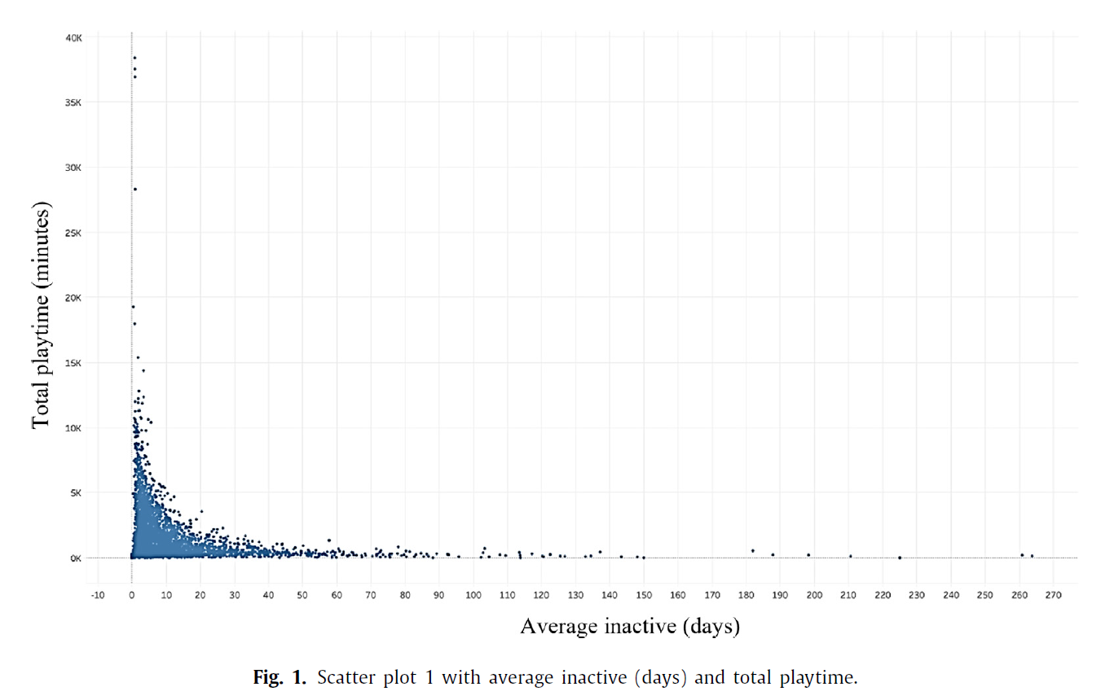

Game (I)
Data Preparation
Churn Definition
Churn Determination
Retention Analysis
Hyperparameter
Prediction
Evaluation
Discussion
Conclusion

Slide 20
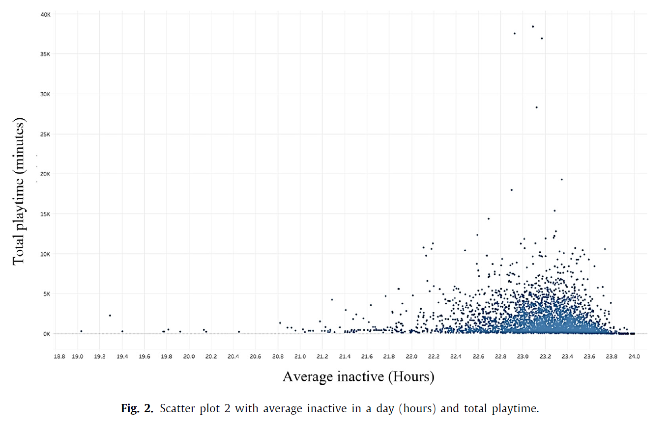
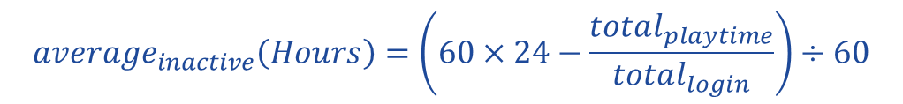
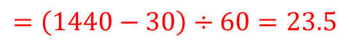
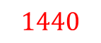
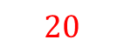
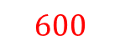
Game ( II )
Data Preparation
$$600$$
$$1440$$
$$average_{inactive}\left(Hours\right)=\left(60×24−\frac{total_{playtime}}{total_{login}}\right)÷60$$
$$=\left(1440−30\right)÷60=23.5$$
Churn Definition
$$20$$
Churn Determination
Retention Analysis
Hyperparameter
Prediction
Evaluation
Discussion
Conclusion

Slide 21
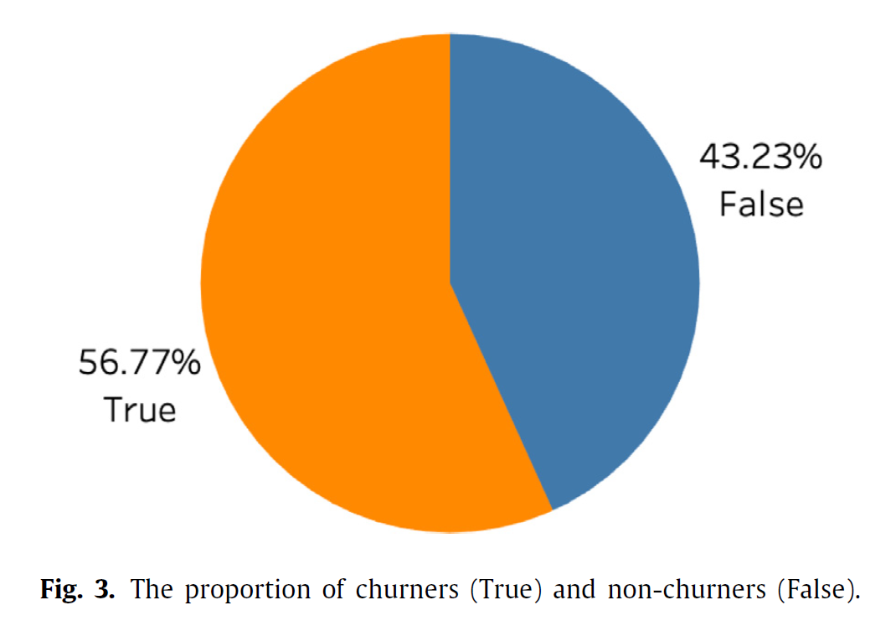
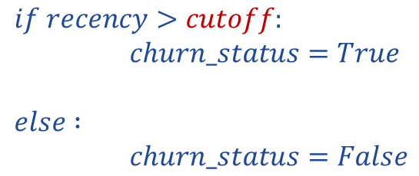

Determination of Churn
Data Preparation
Recency
Avr_inactive
Std_inactive
Churn Definition
Churn Determination
Retention Analysis
Hyperparameter
Prediction
Recency = Jan 28th 2020 – Last Login
$$if recency>cutoff:$$
$churn_status=True$
$$else :$$
$churn_status=False$
Evaluation
$$⇒$$
Discussion
Cutoff = avr + 2 std
Conclusion

Slide 22
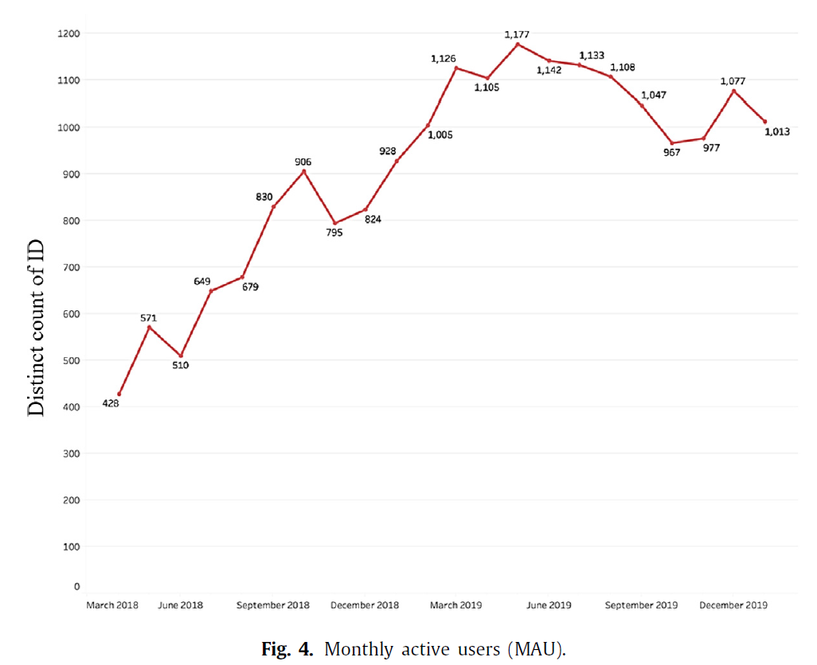
Descriptive Analysis of the User Logs
Data Preparation
Churn Definition
First Year
Reduce User
Churn Determination
Retention Analysis
Hyperparameter
Prediction
Evaluation
Discussion
Conclusion

Slide 23
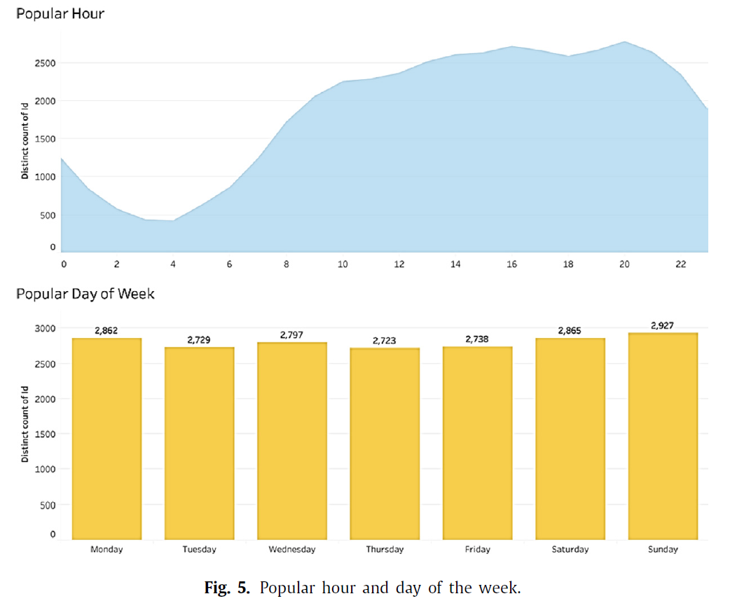
Descriptive Analysis of the User Logs
Data Preparation
STUDENT
ADULTS WORKER
Churn Definition
>
Churn Determination
Retention Analysis
Hyperparameter
Prediction
Evaluation
Discussion
Conclusion

Slide 24
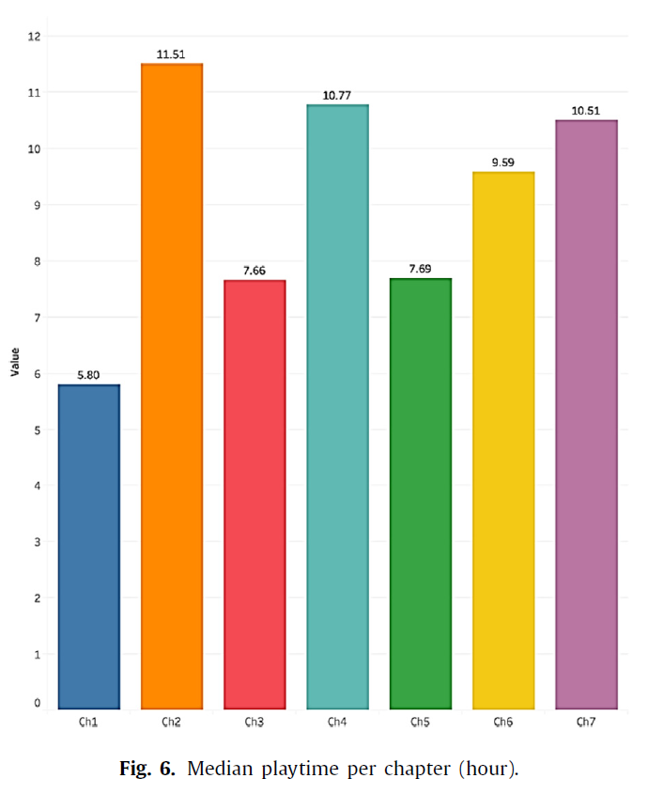
Retention Analysis by Chapter
Data Preparation
Churn Definition
Churn Determination
Retention Analysis
Hyperparameter
Prediction
Evaluation
Discussion
Conclusion
Outlier

Slide 25
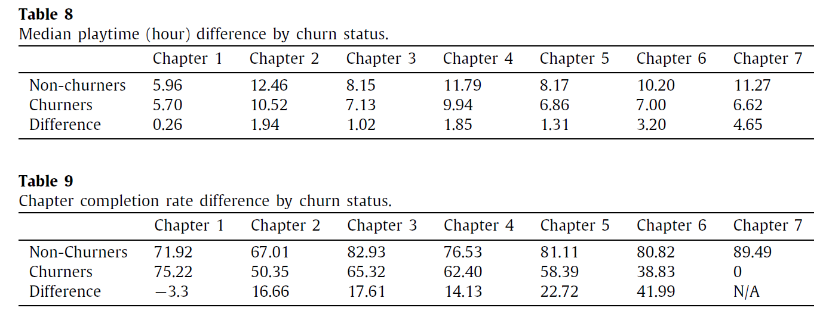

Retention Analysis by Chapter
Data Preparation
Churn Definition
Churn Determination
Retention Analysis
Hyperparameter
25%
SO
Prediction
Churn
Evaluation
Discussion
Conclusion
Shortening or simplify its lesson content

Slide 26
Retention Analysis by Chapter
Data Preparation
Churn Definition
Churn Determination
Retention Analysis
Hyperparameter
SO
Prediction
Churn (in the end)
Evaluation
Discussion
Conclusion
Examining last content of this chapter

Slide 27
Retention Analysis by Chapter
Data Preparation
Churn Definition
Churn Determination
Retention Analysis
Hyperparameter
SO
Prediction
Churn (like chapter 2)
Evaluation
Discussion
Conclusion
Shortening or simplify its lesson content

Slide 28
Retention Analysis by Chapter
Data Preparation
Churn Definition
Churn Determination
Retention Analysis
Hyperparameter
Prediction
Unknown!!!
Evaluation
Discussion
Conclusion
Adding data

Slide 29
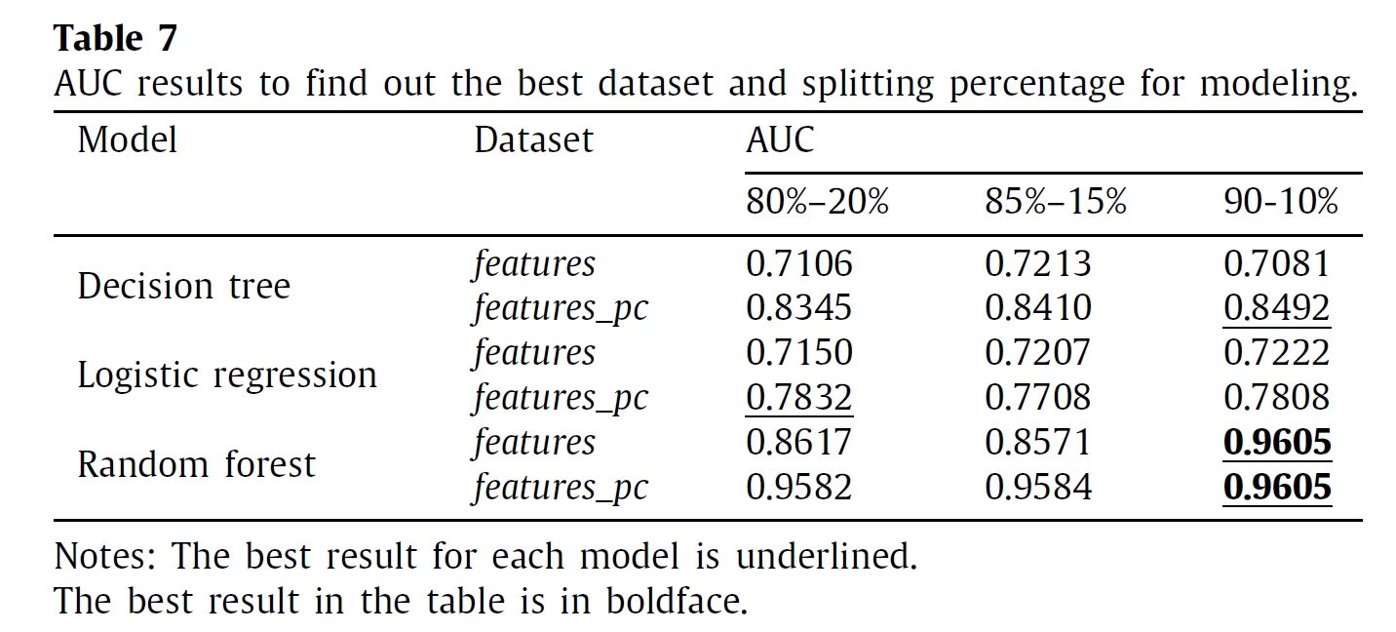
Hyperparameter Optimization
Data Preparation
Churn Definition
Churn Determination
Retention Analysis
Hyperparameter
Prediction
Evaluation
Discussion
Conclusion

Slide 30
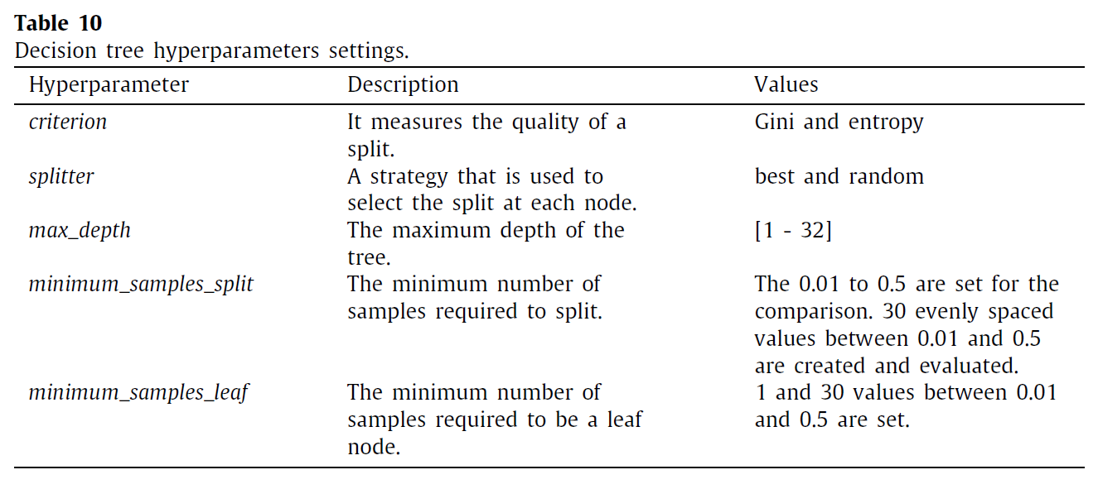
Hyperparameter Optimization
Decision Tree
Data Preparation
Decision Tree
Churn Definition
Churn Determination
Retention Analysis
Random Forest
Hyperparameter
Prediction
Evaluation
Logistic Regression
Discussion
Conclusion

Slide 31
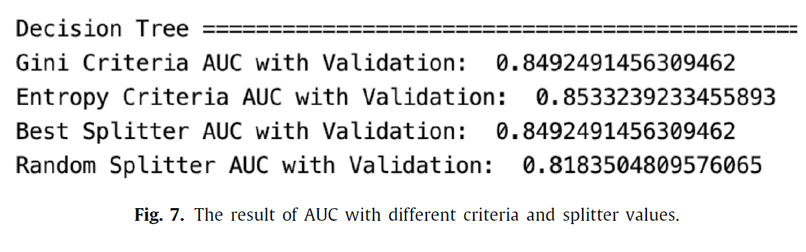
Decision Tree
Data Preparation
Churn Definition
Churn Determination
Retention Analysis
Hyperparameter
Prediction
Evaluation
Discussion
Conclusion

Slide 32
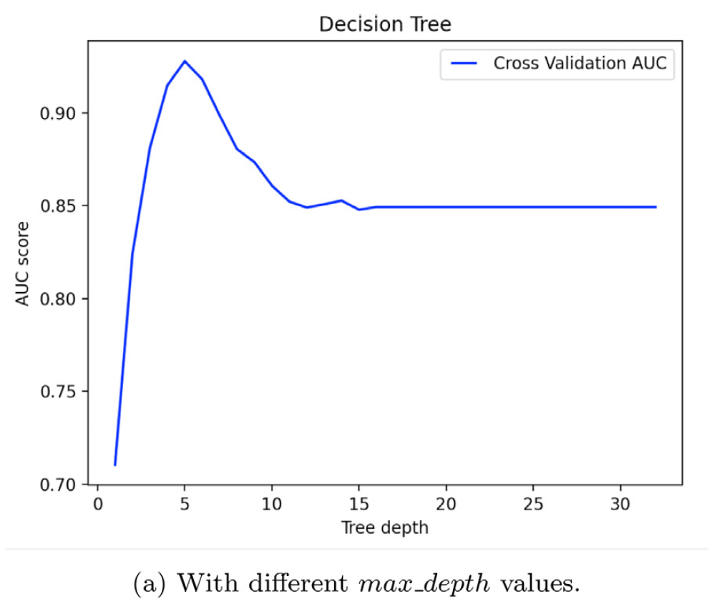
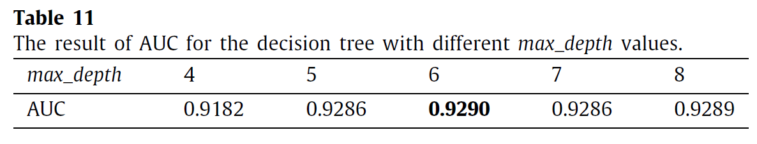
Decision Tree
Data Preparation
Churn Definition
Churn Determination
Retention Analysis
Hyperparameter
Prediction
Evaluation
4 8
Discussion
Conclusion

Slide 33
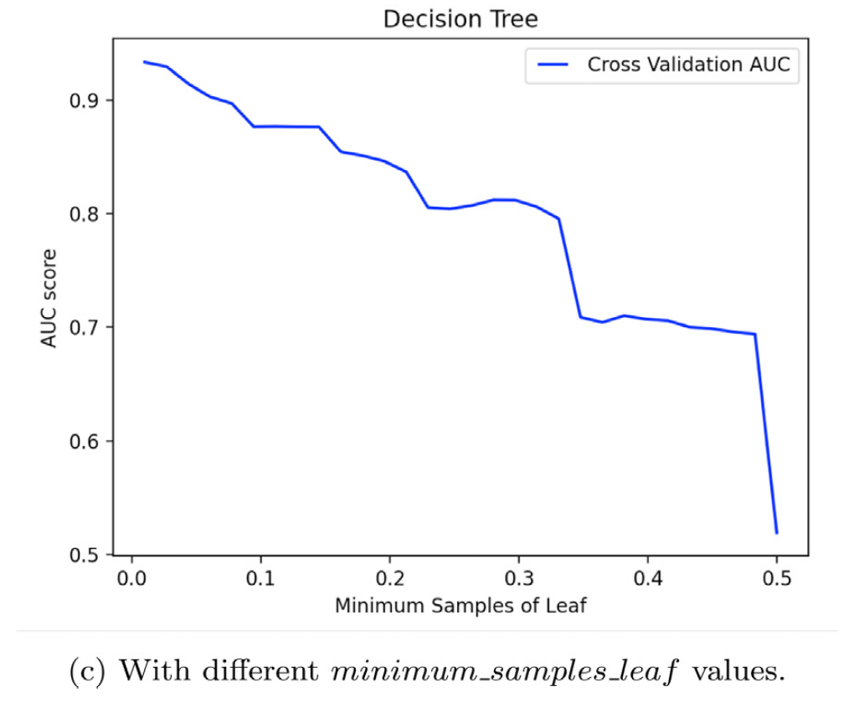
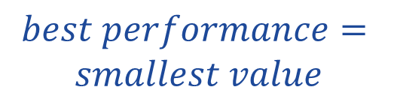
Decision Tree
Data Preparation
Churn Definition
Churn Determination
$$best performance=$$
$$smallest value$$
Retention Analysis
Hyperparameter
Prediction
Evaluation
Discussion
Conclusion

Slide 34
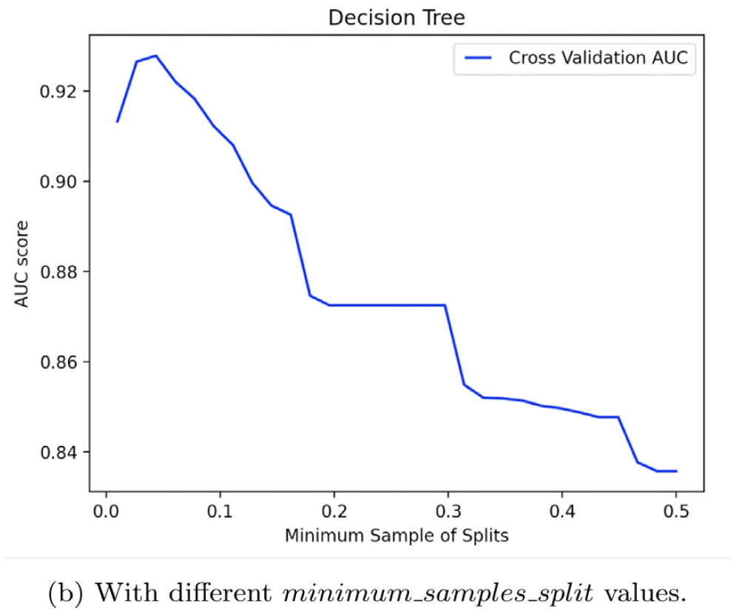
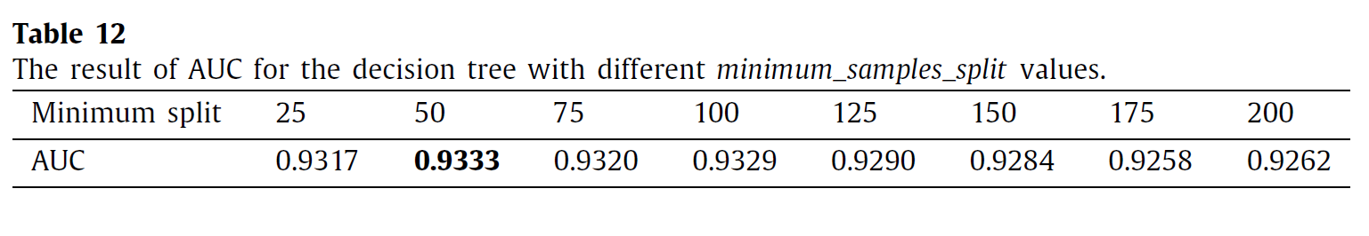
Decision Tree
Data Preparation
Churn Definition
Churn Determination
Retention Analysis
Hyperparameter
Prediction
Evaluation
Discussion
Conclusion

Slide 35
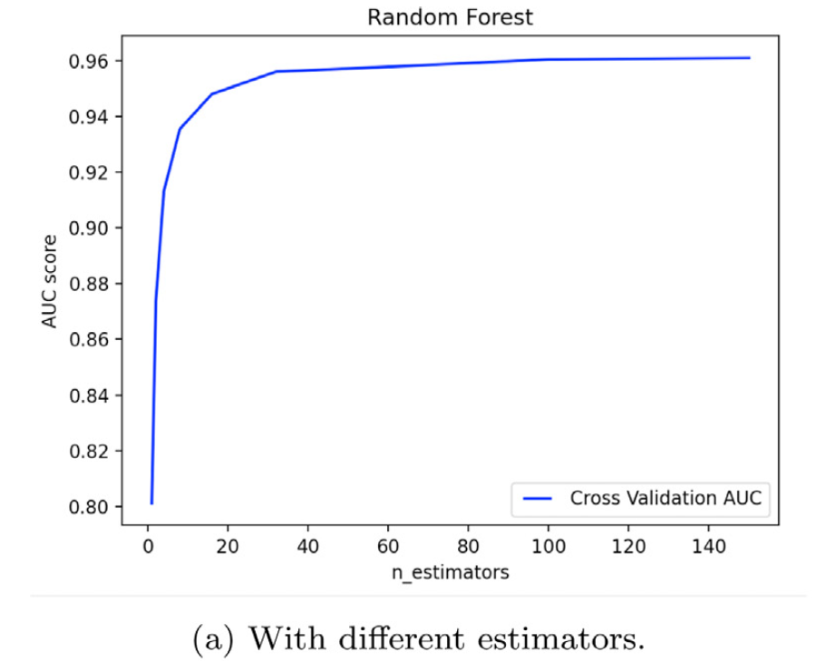
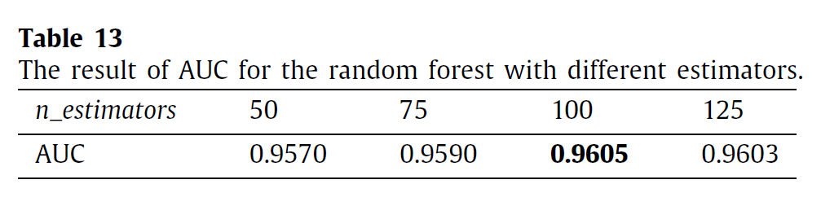
Hyperparameter Optimization
Random Forest
Data Preparation
Decision Tree
Churn Definition
Churn Determination
Retention Analysis
Random Forest
Hyperparameter
Prediction
Evaluation
Logistic Regression
Discussion
Conclusion

Slide 36
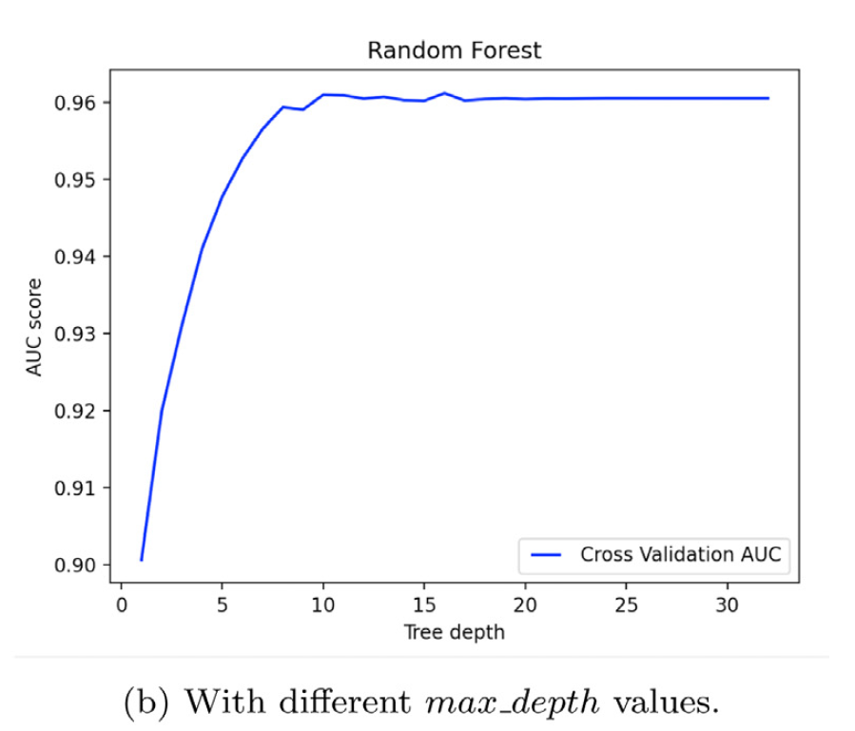
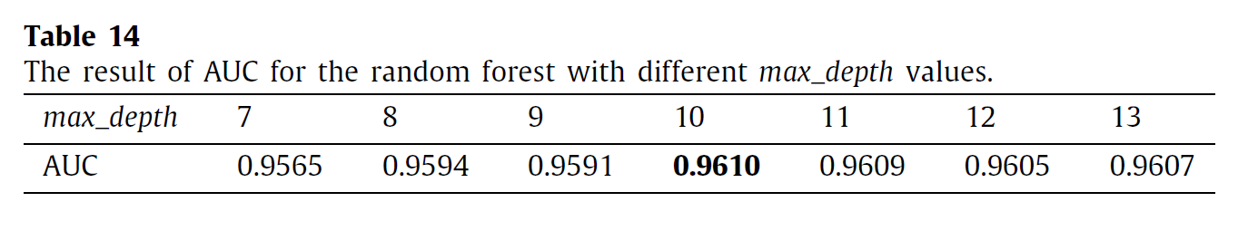
Hyperparameter Optimization
Random Forest
Data Preparation
Churn Definition
Churn Determination
Retention Analysis
Hyperparameter
Prediction
Evaluation
Discussion
Conclusion

Slide 37
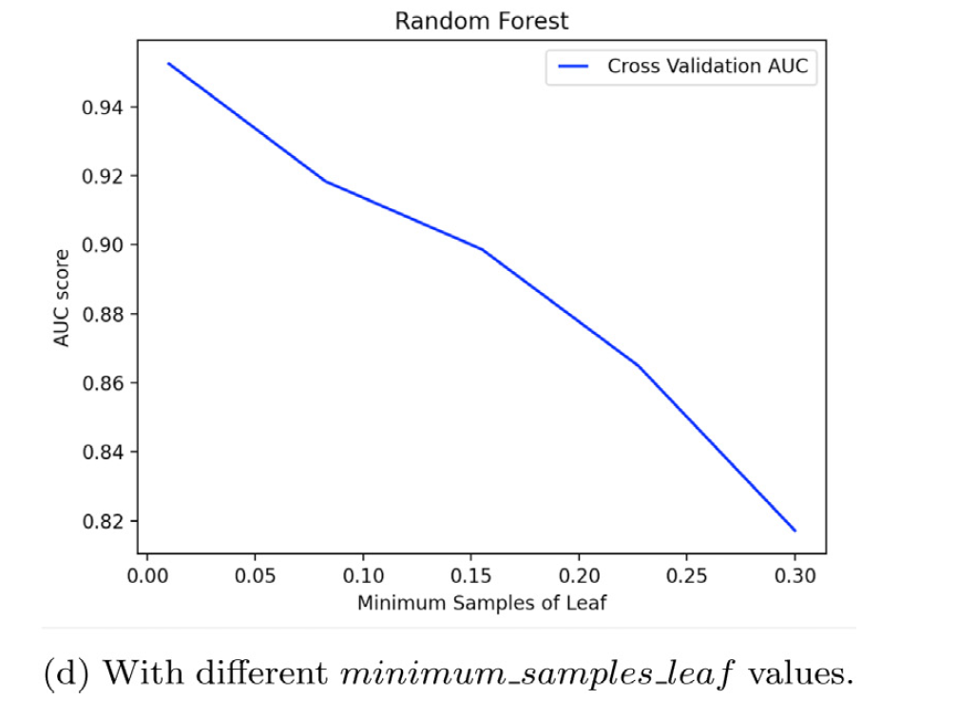
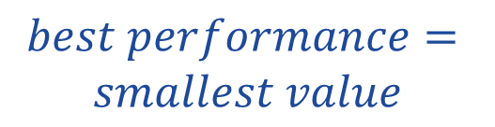
Hyperparameter Optimization
Random Forest
Data Preparation
Churn Definition
Churn Determination
$$best performance=$$
$$smallest value$$
Retention Analysis
Hyperparameter
Prediction
Evaluation
Discussion
Conclusion

Slide 38
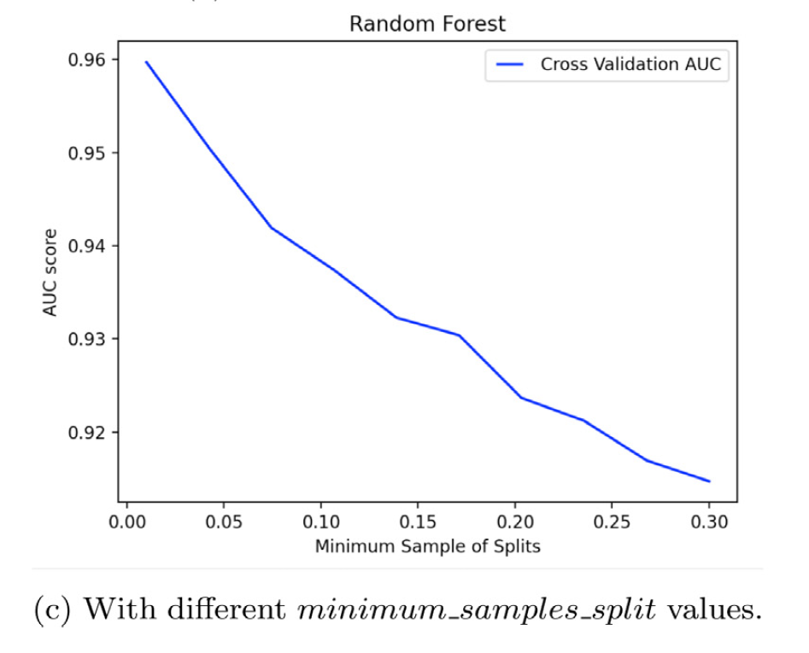
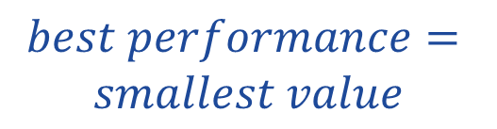
Hyperparameter Optimization
Random Forest
Data Preparation
Churn Definition
Churn Determination
$$best performance=$$
$$smallest value$$
Retention Analysis
Hyperparameter
Prediction
Evaluation
Discussion
Conclusion

Slide 39
Hyperparameter Optimization
Logistic Regression
Data Preparation
Decision Tree
Penalty (L1 , L2)
Inverse of regularization strength (C)
Churn Definition
Churn Determination
Retention Analysis
Random Forest
Hyperparameter
Prediction
Evaluation
Logistic Regression
Discussion
Conclusion

Slide 40
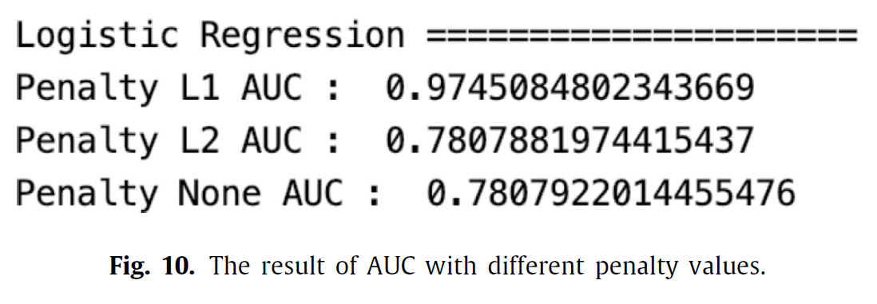
Logistic Regression
Data Preparation
Churn Definition
Churn Determination
Retention Analysis
Hyperparameter
Prediction
Evaluation
Discussion
Conclusion

Slide 41
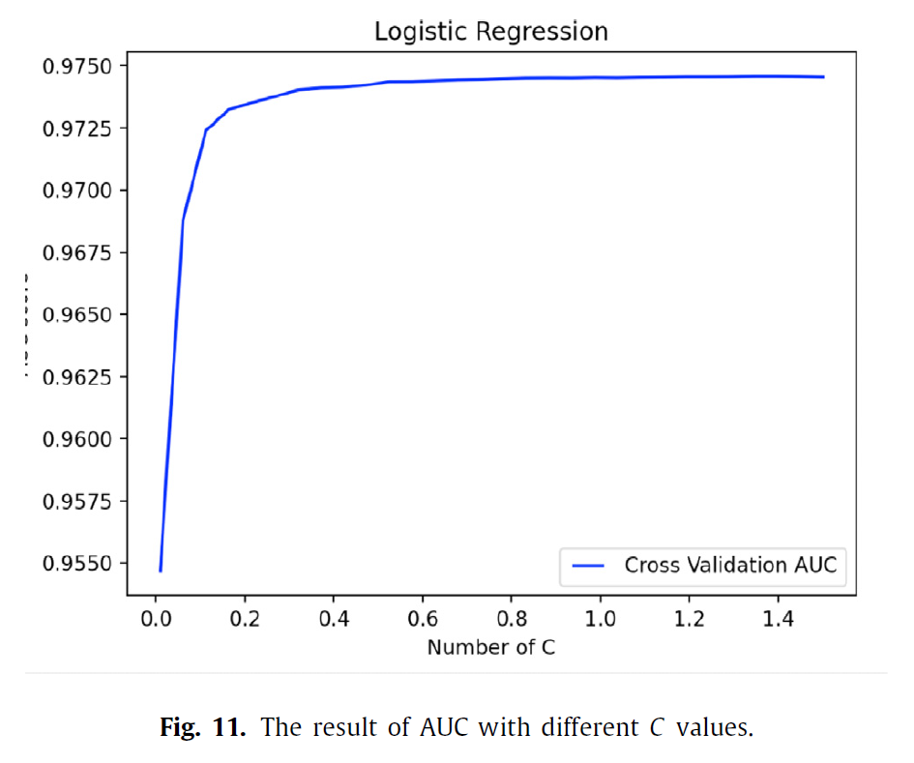

Logistic Regression
Data Preparation
Churn Definition
Churn Determination
Retention Analysis
Hyperparameter
Prediction
Evaluation
Discussion
Conclusion

Slide 42



Hyperparameter Optimization
Data Preparation
Decision Tree
Random Forest
Logistic Regression
Churn Definition
Churn Determination
$criterion$ = “entropy”
$splitter$ = best
$max_depth$ = 6
$min_samples_split$ = 50
$min_samples_leaf$ = 1
$criterion$ = “entropy”
$splitter$ = best
$max_depth$ = 10
$min_samples_split$ = 2
$min_samples_leaf$ = 1
$n_estimators$ = 100
$penalty$ = “L1”
$C$ = 0.9
Retention Analysis
Hyperparameter
Prediction
Evaluation
Discussion
Conclusion

Slide 43
Modeling and Churn Prediction
Data Preparation
Churn Definition
Churn Determination
Retention Analysis
Hyperparameter
Prediction
Evaluation
Discussion
Conclusion

Slide 44




Model Evaluation
Data Preparation
Churn Definition
Churn Determination
Retention Analysis
Hyperparameter
Precision = $\frac{TP}{TP+FP}$
Recall = $\frac{TP}{TP+TN}$
F1-score = $2×\frac{precision . recall}{precision+recall}$
Prediction
Evaluation
Discussion
Conclusion

Slide 45





Model Evaluation
Data Preparation
Churn Definition
Churn Determination
Retention Analysis
Hyperparameter
$$\frac{232}{356}=65.16\% > 56.7\%$$
Prediction
Evaluation
Discussion
More bias $⇒$
Weighted avg
Conclusion

Slide 46

Model Evaluation
Data Preparation
Churn Definition
Churn Determination
Retention Analysis
Hyperparameter
Logistic regression
Prediction
Evaluation
Discussion
Conclusion

Slide 47
LR is Better than DT and RF
Data Preparation
LR tends to overfit with high dimensional data, but a low dimensional dataset was used.
LR works well with linearly separatable datasets, whereas DT has less efficiency with continuous numerical data.
Many of the used dataset variables are continuous numerical variables with a wide-range and more significant gap between mean and standard deviation, so this could affect the tree-based models, and worked better with LR model than DT and RF.
Churn Definition
Churn Determination
Retention Analysis
Hyperparameter
Prediction
Evaluation
Discussion
Conclusion

Slide 48
Discussion
Data Preparation
The defined churn can be helpful to many DGBL services.
Three categories (demographic, engagement, and performance) can be implemented with any DGBL company.
This approach allows us to have the flexibility to define churners even if the users are playing in mid-course.
The applicability and flexibility of the proposed churn determination can handle the challenges.
Churn Definition
Churn Determination
Retention Analysis
Hyperparameter
Prediction
Evaluation
Discussion
Conclusion

Slide 49

Discussion

Slide 50
Thanks for your attention
Churn Prediction in digital game-based
learning using data mining techniques:
Linear regression, decision tree, and
random forest

